Slide 1
Choose From The Following Options
Option-i
Option-2
Option-3
SURE
IMPOSSIBLE
MAY BE

Slide 2

SUN RISES IN THE EAST

Slide 3
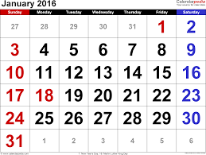
FEBRUARY-2016FFFFFFFFFFFFFBE

Slide 4
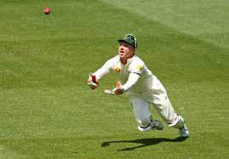
CATCH WILL BE TAKEN

Slide 5
2
2
5
+
==

Slide 6
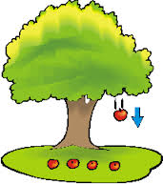

Slide 7

CANDIDATE WILL BE SELECTED FOR THE JOB

Slide 8
IN MATHEMATICS
THIS “MAYBE” IS TERMED AS PROBABLe
And
Its value is called
probability

Slide 9


INTRODUCING
PROBABILITY

Slide 10
NUMERICALLY
1
sure
Sure means 1
Impossible means 0
The value of probability
lies between 0 and 1
probable
0
Impossible

Slide 11
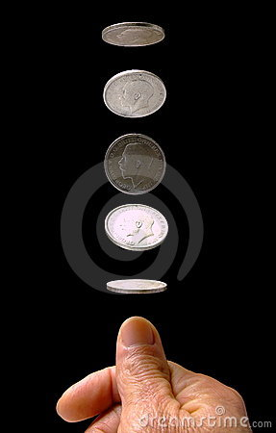
Toss a coin

Slide 12
Terms used in probability
Trial :- till the coin is in the air, it is a trial .

Slide 13
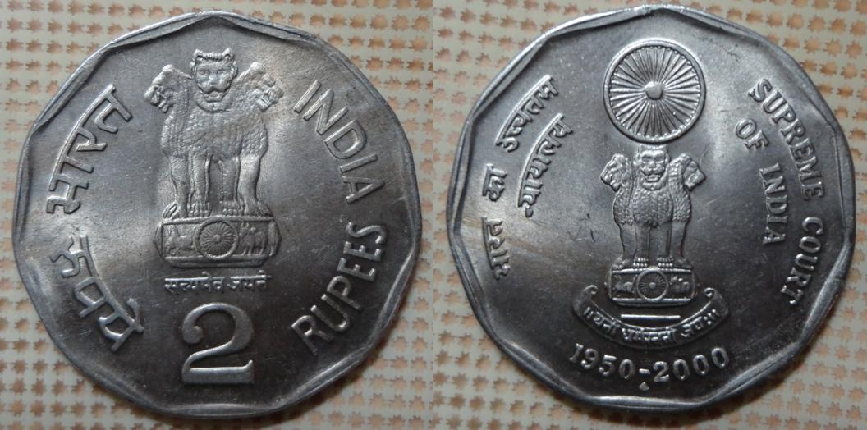
event : when the coin hits the ground, it becomes an event
Sample space:-it is the total possible events {h,t}

Slide 14
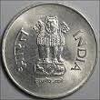
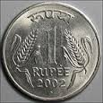
Favourable outcomes:-your choice (a head or a tail)
P ( e ) = no. of favourable outcomes
total no of outcomes

Slide 15
Probability of getting a head
Probability = number of favourable outcomes
total number of outcomes
Favourable outcomes = 1
Total number of outcomes = 2
Probability = 1
2

Slide 16

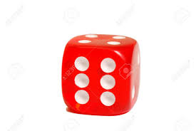
Practice question
Q. a dice is rolled once. What is the probability of getting an even number.

Slide 17
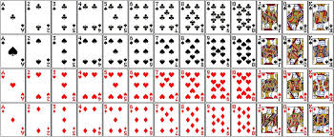
52 CARDS
26 RED
13 DIAMOND 13 HEART
26 BLACK
13 CLUBS 13 SPADE

Slide 18
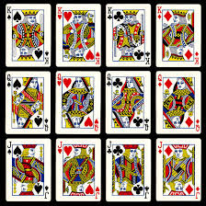
PICTURE CARDS
( 12 )
4 KINGS…4 QUEENS…4 JACKS

Slide 19
A card is selected from 52 cards.Find the probability that the card is
a black card
a king
a spade
5 of clubs
a Queen of Red colour
an Ace

Slide 20
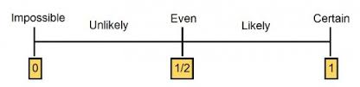

Slide 21
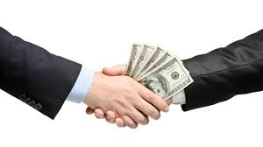

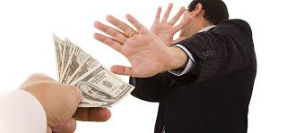

Slide 23
Find the probability that a mother is responsible to give birth to a girl child ?
Sex is determined by two chromosomes , X and Y.
A female is XX , a male is XY .
women completely lack the Y chromosome , they always contribute an X chromosome to the baby.
The sex is determined by whether the sperm that fertilizes the egg is carrying another X or Y.
Men determine the sex of a baby depending on whether their sperm is carrying an X or Y chromosome.
An X chromosome combines with the mother's X chromosome to make a baby girl (XX) and a Y chromosome will combine with the mother's to make a boy (XY).

Slide 24
THANK YOU

